Slide 1
Batch size = 256 (512 performs significantly better but colab ran out)
Dropout = 0.1 (might need to be higher cause overfitting due to smaller batch size)
Epoch = 15 (can be smaller if batch size increase)
Baseline | Actual
Predicted |  | Normal | Carrying | Threat
 | Normal | 282 | 82 | 46
 | Carrying | 13 | 153 | 14
 | Threat | 16 | 46 | 238
Accuracy 0.75
Modified | Actual
Predicted |  | Normal | Carrying | Threat
 | Normal | 164 | 14 | 5
 | Carrying | 82 | 234 | 59
 | Threat | 65 | 33 | 234
Accuracy 0.71
False negative of actual carrying/threat but predicted normal significantly decrease

Slide 2
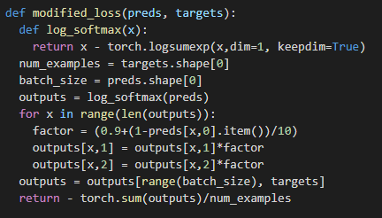
Modification made to cross entropy loss to reduce false negative.
Classic way is to change probability cutoff for class predictions.
Eg
predictions: [0.3,0.6,0.1]
actual : [0,1,0]
Cross entropy will only take the log softmax value of class 1, the 0.6 value
Idea is to modify the logsoftmax value of class 1 and 2 by a factor of class 0.
If class 0 prediction is high when actual is class 1 or 2, the change in logsoftmax value of class 1 and 2 is larger.
Formula used here →
0.9 used so that it wont change too much
Possible further exploration to find out what change is optimal.

